Slide 1

Functional Annotation Lesson 2
Inferring function from homologous matches
Limitations of ortholog match
BLAST+
DIAMOND

Slide 2
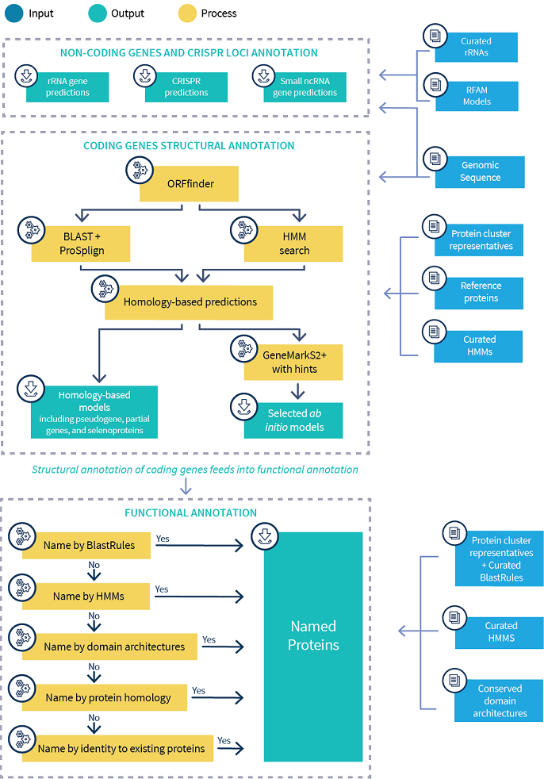
NCBI PGAP Prokaryotic Genome Annotation Pipeline

Slide 3
Homology ≠ similarity in function
No scoring schema provides “biological truth”
With enough modification - gap inclusions, similarity scores, etc. - ANY pair of sequences can be aligned
Proteins can have similar functions at 30% amino acid identity
Proteins can have different functions at 95% amino acid identity
Context of the match is important

Slide 4
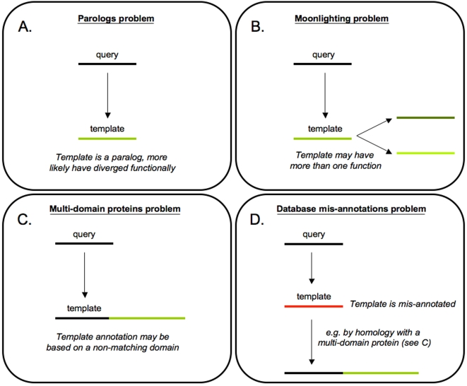
Why homology ≠ similarity in function
Punta & Ofran. PLOS Comp Biol. 2008

Slide 5
BLAST+
Program | Input format | Database
blastn | nucleotide | nucleotide
blastp | protein | protein
blastx | translated nucleotide | protein
tblastn | protein | translated nucleotide
tblastx | translated nucleotide | translated nucleotide
BLAST (Basic Local Alignment Search Tool) is an algorithm for comparing primary biological sequence information, such as the amino-acid sequences of different proteins or the nucleotides of DNA sequences (Wikipedia)
http://www.hypothesisjournal.com/wp-content/uploads/2011/08/boutros-3-1-fig2.png
https://open.oregonstate.education/computationalbiology/chapter/command-line-blast/

Slide 6
BLAST+
Task | Description
blastn | Traditional blastn search
blastn-short | Optimized for queries <50bp
megablast | Optimized for seqs with high similarity
dc-megablast | Optimized for distant seqs
blastp | Traditional blastp search
blastp-short | Optimized for queries <30aa
Microsoft Azure Notebooks – sanger-pathogens

Slide 7
Interpreting local alignments
https://open.oregonstate.education/computationalbiology/chapter/command-line-blast/

Slide 8
Interpreting local alignments
Talla (2003)

Slide 9
Alternative local alignment tools
BLAST (1990)
USEARCH (2010)
DIAMOND (2015)
Only supports local alignments
Default e-value 10 – high error rate
For each query sequence, the reference sequences with the best matches are returned
Requires BLAST formatted database
Supports local and global alignments
Global alignments make sense for searches where the similarity of the whole sequence is important
e.g. 16S rRNA
USEARCH for top hit(s) at higher identities
UBLAST, which is slower but sensitive to lower identities
Reduces search time by returning only a few high-quality matches rather than considering all possible matches
Aligns short sequence reads at approximately 20,000 times the speed of BLAST and has a similar level of sensitivity.
Constructs a double index to traverse query and reference seeds more quickly
An 'all mapper' that attempts to determine exhaustively all significant alignments for a given query
Requires DIAMOND formatted database

Slide 10
Lesson 3
Predicting function using position-sensitive models

